Slide 1
Working with Files and Directories

Slide 2
Overview
Work with application data on the device
Practice good file management
Understand Android file permissions
Work with files and directories
Explore the Android application directories
Create and write to files in the default application directory
Read from files in the default application directory
Read raw files byte by byte
Read XML files
Work with other directories and files on the Android file system
Create and write files to external storage

Slide 3
Working with Application Data on the Device
Many applications require a robust solution for storing data persistently
Some types of data that an application might want to store include
  Multimedia content such as images, sounds, video, and other complex information
  Content downloaded from a network
  Complex content generated by the application
Notes:
Multimedia content such as images, sounds, video, and other complex information
These types of data structures are not supported as shared preferences. You may, however, store a shared preference that includes the file path or URI to the multimedia, and store the multimedia on the device file system or download it just when needed.
Content downloaded from a network
As mobile devices, Android devices are not guaranteed to have persistent network connections. Ideally, an application will download content from the network once and keep it as long as necessary. Sometimes content should be kept indefinitely, whereas other circumstances simply require content to be cached for a time.
Complex content generated by the application
Android devices function under stricter memory and storage constraints than desktop computers and servers do. Therefore, if your application has taken a long time to process data and come up with a result, that result should be stored for reuse, as opposed to re-creating it on demand.

Slide 4
Working with Application Data on the Device (Cont’d)
Android applications can create and use directories and files to store their data in a variety of ways, most commonly
  Storing private application data under the application directory
  Caching data under the application’s cache directory
  Storing shared application data on external storage devices or shared device directory areas

Slide 5
Practicing Good File Management
Here are a few of the most important best practices for working with files on the Android file system:
  Anytime you read or write data to disk, you are performing intensive blocking operations and using valuable device resources; therefore, in most cases, file access functionality should not be performed on the main UI thread of an application
  Instead, these operations should be handled asynchronously using threads, AsyncTask objects, or other asynchronous methods

Slide 6
Practicing Good File Management (Cont’d)
More best practices:
  Even working with small files can slow down the UI thread due to the nature of the underlying file system and hardware
  Android devices have limited storage capacity; therefore, store only what you need to store, and clean up old data when it is no longer needed to free up space on the device
  Use external storage whenever it is appropriate to give the user more flexibility

Slide 7
Practicing Good File Management (Cont’d)
More best practices:
  Be a good citizen on the device
    Check for availability of resources such as disk space and external storage opportunities prior to using them and causing errors or crashes
  Don’t forget to set appropriate file permissions for new files
  Release resources when you’re not using them
    In other words, if you open them, close them, and so on

Slide 8
Practicing Good File Management (Cont’d)
More best practices:
  Implement efficient file access algorithms for reading, writing, and parsing file contents
  Use the many profiling tools available as part of the Android SDK to identify and improve the performance of your code
    A good place to start is with the StrictMode API
      android.os.StrictMode
  If the data the application needs to store is well structured, consider using a SQLite database to store it

Slide 9
Practicing Good File Management (Cont’d)
More best practices:
  Test your application on real devices; different devices have different processor speeds
  Do not assume that because your application runs smoothly on the emulator it will run as such on real devices
  If you’re using external storage, test when external storage is not available

Slide 10
Understanding Android File Permissions
Each Android application is its own user on the underlying Linux operating system; it has its own application directory and files
Files created in the application’s directory are private to that application by default
Files can be created on the Android file system with different permissions specifying how the files are accessed
Permission modes are most commonly used when creating files
These permission modes are defined in the Context class (android.content.Context)
  MODE_PRIVATE (the default) is used to create a file that can be accessed only by the “owner” application itself
    From a Linux perspective, this means the specific user identifier
    The constant value of MODE_PRIVATE is 0, so you may see this used in legacy code
  MODE_APPEND is used to append data to the end of an existing file
    The constant value of MODE_APPEND is 32768

Slide 11
Understanding Android File Permissions (Cont’d)
An application does not need any special Android manifest file permissions to access its own private file system area
However, in order for your application to access external storage, it will need to register for the WRITE_EXTERNAL_STORAGE permission

Slide 12
Working with Files and Directories
Within the Android SDK, you can also find a variety of standard Java file utility classes (such as java.io) for handling different types of files, such as
  Text files
  Binary files
  XML files
In Chapter 6, “Managing Application Resources,” you learned that Android applications can also include raw and XML files as resources
Retrieving the file handle to a resource file is performed slightly differently from accessing files on the device file system, but once you have a file handle, either method allows you to perform read operations and the like in the same fashion
After all, a file is a file

Slide 13
Working with Files and Directories (Cont’d)
Android application file resources are part of the application package and are therefore accessible only to the application itself
What about file system files?
Android application files are stored in a standard directory hierarchy on the Android file system

Slide 14
Working with Files and Directories (Cont’d)
Applications access the Android device file system using methods within the Context class
  android.content.Context
The application, or any Activity class, can use the application Context to access its private application file directory or cache directory
From here, you can add, remove, and access files associated with your application
By default, these files are private to the application and cannot be accessed by other applications or by the user

Slide 15
Exploring with the Android Application Directories
Android application data is stored on the Android file system in the following top-level directory:
  /data/data/<package name>/
Several default subdirectories are created for storing databases, preferences, and files as necessary
The actual location of these directories varies by device
You can also create other custom directories as needed
File operations all begin by interacting with the application Context object

Slide 16
Exploring with the Android Application Directories (Cont’d)
Method | Purpose
Context.deleteFile() | Deletes a private application file by name
Context.fileList() | Gets a list of all files in the /files subdirectory
Context.getCacheDir() | Retrieves the application /cache subdirectory
Context.getDir() | Creates or retrieves a named application subdirectory
Context.getExternalCacheDir() | Retrieves the /cache subdirectory on the external file system (API Level 8)
Context.getExternalFilesDir() | Retrieves the /files subdirectory on the external file system (API Level 8)
Context.getFilesDir() | Retrieves the application /files subdirectory
Context.getFileStreamPath() | Returns the absolute file path to the application /files subdirectory
Context.openFileInput() | Opens a private application file for reading
Context.openFileOutput() | Opens a private application file for writing
Notes:
This table lists some important methods available for application file management. You can use all the standard java.io package utilities to work with FileStream objects and such.

Slide 17
Creating and Writing to Files in the Default Application Directory
Android applications that require only the occasional file to be created should rely upon the helpful Context class method called openFileOutput()
Use this method to create files in the default location under the application data directory:
  /data/data/<package name>/files/

Slide 18
Creating/Writing to Files in the Default App Directory (Cont’d)
The following code snippet creates and opens a file called Filename.txt
We write a single line of text to the file and then close the file
    import java.io.FileOutputStream;
    ...
    FileOutputStream fos;
    String strFileContents = "Some text to write to the file.";
    fos = openFileOutput("Filename.txt", MODE_PRIVATE);
    fos.write(strFileContents.getBytes());
    fos.close();

Slide 19
Creating/Writing to Files in the Default App Directory (Cont’d)
We can append data to the file by opening it with the mode set to MODE_APPEND:
    import java.io.FileOutputStream;
    ...
    FileOutputStream fos;
    String strFileContents = "More text to write to the file.";
    fos = openFileOutput("Filename.txt", MODE_APPEND);
    fos.write(strFileContents.getBytes());
    fos.close();

Slide 20
Creating/Writing to Files in the Default App Directory (Cont’d)
The file we just created has the following path on the Android file system:
  /data/data/<package name>/files/Filename.txt

Slide 21
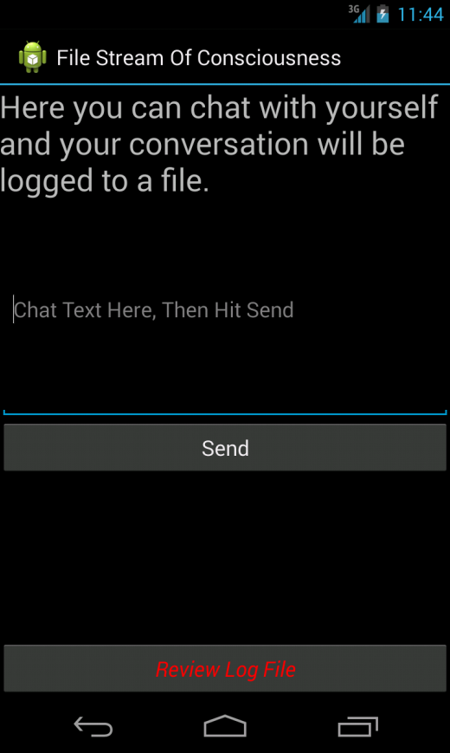
Creating/Writing to Files in the Default App Directory (Cont’d)
Notes:
This screen capture shows an Activity that is configured to collect text input from a user, and then write the information to a text file when Send is clicked.

Slide 22
Reading from Files in the Default Application Directory
Again we have a shortcut for reading files stored in the default /files subdirectory
The following code snippet opens a file called Filename.txt for read operations:
    import java.io.FileInputStream;
    ...
    String strFileName = "Filename.txt";
    FileInputStream fis = openFileInput(strFileName);

Slide 23
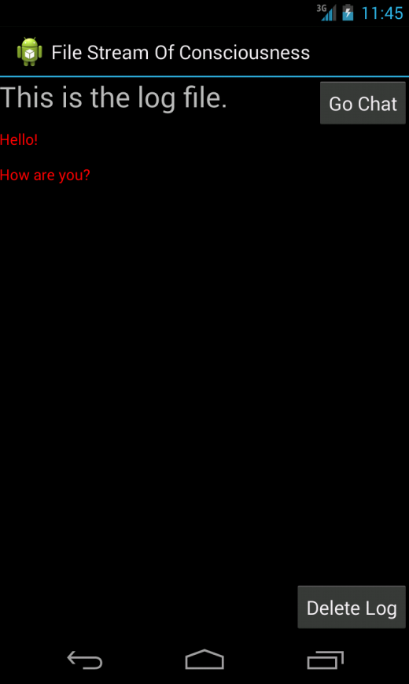
Reading from Files in the Default Application Directory (Cont’d)
Notes:
This screen capture shows an Activity that is configured to read the information from a text file upon launching of the Activity.

Slide 24
Reading Raw Files Byte by Byte
You handle file-reading and file-writing operations using standard Java methods
The java.io.InputStreamReader and java.io.BufferedReader are used for reading bytes and characters from different types of primitive file types

Slide 25
Reading Raw Files Byte by Byte (Cont’d)
  FileInputStream fis = openFileInput(filename);
  StringBuffer sBuffer = new StringBuffer();
  BufferedReader dataIO = new BufferedReader (new InputStreamReader(fis));
  String strLine = null;
  while ((strLine = dataIO.readLine()) != null) {
  sBuffer.append(strLine + "\n");
  }
  dataIO.close();
  fis.close();
Notes:
Here’s a simple example of how to read a text file, line by line, and store it in a StringBuffer.

Slide 26
Reading XML Files
Package or Class | Purpose
android.sax.* | Framework to write standard SAX handlers
android.util.Xml | XML utilities, including the XMLPullParser creator
org.xml.sax.* | Core SAX functionality (project: http://www.saxproject.org/)
javax.xml.* | SAX and limited DOM, Level 2 Core support
org.w3c.dom | Interfaces for DOM, Level 2 Core
org.xmlpull.* | XmlPullParser and XMLSerializer interfaces as well as a SAX2 Driver class (project: http://www.xmlpull.org/)
Notes:
The Android SDK includes several utilities for working with XML files, including SAX, an XML Pull Parser, and limited DOM, Level 2 Core support. This table lists the packages helpful for XML parsing on the Android platform.

Slide 27
Reading XML Files (Cont’d)
      <?xml version="1.0" encoding="UTF-8"?>
      <!-- Our pet list -->
      <pets>
      <pet type="Bunny" name="Bit"/>
      <pet type="Bunny" name="Nibble"/>
      <pet type="Bunny" name="Stack"/>
      <pet type="Bunny" name="Queue"/>
      <pet type="Bunny" name="Heap"/>
      <pet type="Bunny" name="Null"/>
      <pet type="Fish" name="Nigiri"/>
      <pet type="Fish" name="Sashimi II"/>
      <pet type="Lovebird" name="Kiwi"/>
      </pets>
Notes:
Your XML parsing implementation will depend on which parser you choose to use. Back in Chapter 6, we discussed including raw XML resource files in your application package. Here is a simple example of how to load an XML resource file and parse it using an XmlPullParser.

Slide 28
Reading XML Files (Cont’d)
XmlResourceParser myPets = getResources().getXml(R.xml.my_pets);
int eventType = -1;
while (eventType != XmlResourceParser.END_DOCUMENT) {
if(eventType == XmlResourceParser.START_DOCUMENT) {
Log.d(DEBUG_TAG, "Document Start");
} else if(eventType == XmlResourceParser.START_TAG) {
String strName = myPets.getName();
if(strName.equals("pet")) {
Log.d(DEBUG_TAG, "Found a PET");
Log.d(DEBUG_TAG, "Name: "+ myPets.getAttributeValue(null,
"name"));
Log.d(DEBUG_TAG, "Species: "+ myPets.getAttributeValue(null,
"type"));
}
}
eventType = myPets.next();
}
Log.d(DEBUG_TAG, "Document End");
Notes:
The following code illustrates how to parse the preceding XML using a special pull parser designed for XML resource files.

Slide 29
Working with Other Directories and Files on the File System
Using Context.openFileOutput() and Context.openFileInput() method calls is great if you have a few files and you want them stored in the application’s private /files subdirectory
If you have more sophisticated file management needs, you need to set up your own directory structure
To do this, you must interact with the Android file system using the standard java.io.File class methods

Slide 30
Working with Other Directories and Files on the File System (Cont’d)
    import java.io.File;
    ...
    File pathForAppFiles = getFilesDir();
    String[] fileList = pathForAppFiles.list();
Notes:
The following code retrieves the File object for the /files application subdirectory and retrieves a list of all filenames in that directory.

Slide 31
Working with Other Directories and Files on the File System (Cont’d)
  import java.io.File;
  import java.io.FileOutputStream;
  ...
  File fileDir = getFilesDir();
  String strNewFileName = "myFile.dat";
  String strFileContents = "Some data for our file";
  File newFile = new File(fileDir, strNewFileName);
  newFile.createNewFile();
  FileOutputStream fo = new FileOutputStream(newFile.getAbsolutePath());
  fo.write(strFileContents.getBytes());
  fo.close();
Notes:
Here is a more generic method to create a file on the file system. This method works anywhere on the Android file system you have permission to access, not just the /files directory.

Slide 32
Working with Other Directories and Files on the File System (Cont’d)
You can use File objects to manage files within a desired directory and create subdirectories
You might want to store “track” files within “album” directories or create a file in a directory other than the default
Let’s say you want to cache some data to speed up your application’s performance and how often it accesses the network
  In this instance, you might want to create a cache file
There is a special application directory for storing cache files on the Android file system, retrievable with a call to the getCacheDir() method:
  /data/data/<package name>/cache/
The external cache directory, found via a call to the getExternalCacheDir() method, is not treated the same in that files are not automatically removed from it

Slide 33
Working with Other Directories and Files on the File System (Cont’d)
  File pathCacheDir = getCacheDir();
  String strCacheFileName = "myCacheFile.cache";
  String strFileContents = "Some data for our file";
  File newCacheFile =
  new File(pathCacheDir, strCacheFileName);
  newCacheFile.createNewFile();
  FileOutputStream foCache =
  new FileOutputStream(newCacheFile.getAbsolutePath());
  foCache.write(strFileContents.getBytes());
  foCache.close();
  newCacheFile.delete();
Notes:
The following code gets a File object for the /cache application subdirectory, creates a new file in that specific directory, writes some data to the file, closes the file, and then deletes it.

Slide 34
Creating and Writing Files to External Storage
Applications should store large amounts of data on external storage (using the SD card) rather than limited internal storage
You can access external file storage, such as the SD card, from within your application as well
This is a little trickier than working within the confines of the application directory, as SD cards are removable
So you need to check to see if the storage is mounted before use

Slide 35
Creating and Writing Files to External Storage (Cont’d)
You can access external storage on the device using the Environment class:
  android.os.Environment
Begin by using the getExternalStorageState() method to check the mount status of external storage
You can store private application files on external storage, or you can store public, shared files such as media
If you want to store private application files, use the getExternalFilesDir() method of the Context class
  These files will be cleaned up if the application is uninstalled later
The external cache is accessed using the getExternalCacheDir() method
If you want to store shared files such as pictures, movies, music, ringtones, or podcasts on external storage, you can use the getExternalStoragePublicDirectory() method of the Environment class to get the top-level directory used to store a specific file type

